Slide 1
Maintenance Update
2018 Section Engineer meeting
Jon Wilcoxson, PE – Director of Maintenance

Slide 2
Snow and Ice: Salt Usage to Date

Slide 3
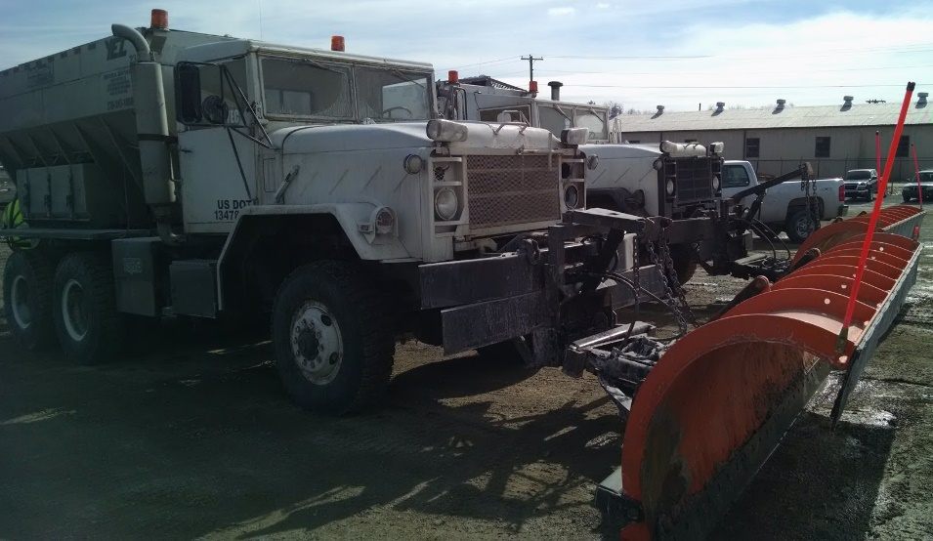
Snow and Ice: Contract Truck Issues
Insufficient Drivers for 24 Hour Operation
Unqualified Drivers
Inoperable Trucks / Breakdowns
Contracts terms vary based on award year.
Districts should document non-performance and report to Division of Purchases.
Contract cancellation is an option.
Notes:
Many districts are reporting that contractors have been unable to fulfill obligations to keep trucks operable throughout extended events. Need to document these issues and discuss with contractor. Ultimately we may have to cancel contracts but this could leave us in a difficult position if we don’t have sufficient in-house resources. In some districts, we only have one contractor who bids, so cancelling contracts is especially problematic.

Slide 4
Snow and Ice: Vendor Salt Deliveries
Timely Deliveries
$1000 deduction per day for exceeding delivery schedule.
Material Quality
Excessively caked or dirty salt can be rejected.
Notes:
Many districts reporting that vendors are not delivering in accordance with their contract. Remember that the vendors chose the number of days when they submitted their bids, and that delivery turnaround was a significant factor in determining the winning bidder. In some cases we’re paying more for the salt because they promised faster delivery. We have to hold them to these terms and apply deductions where applicable.

Slide 5
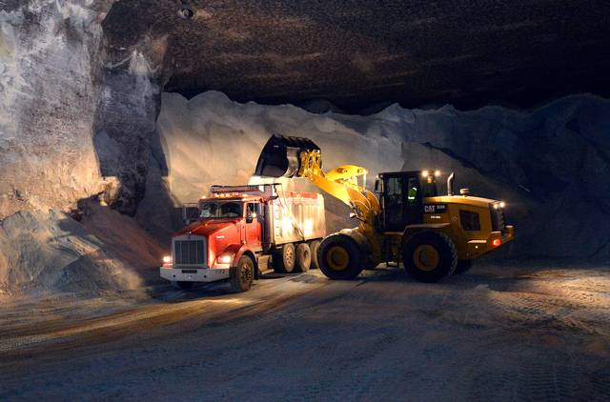
Snow and Ice: Cave Salt Deliveries
FY 2017 guaranteed deliveries were paid by Central Office.
District budgets were never charged.
Deliveries from cave will be charged to district at their 2017 contract price.
Notes:
We have about 150,000 tons still available in the cave. We can make deliveries to districts if needed, but need a few days’ notice. If you think you’ll need salt from the cave, be sure to let us know before an event.

Slide 6
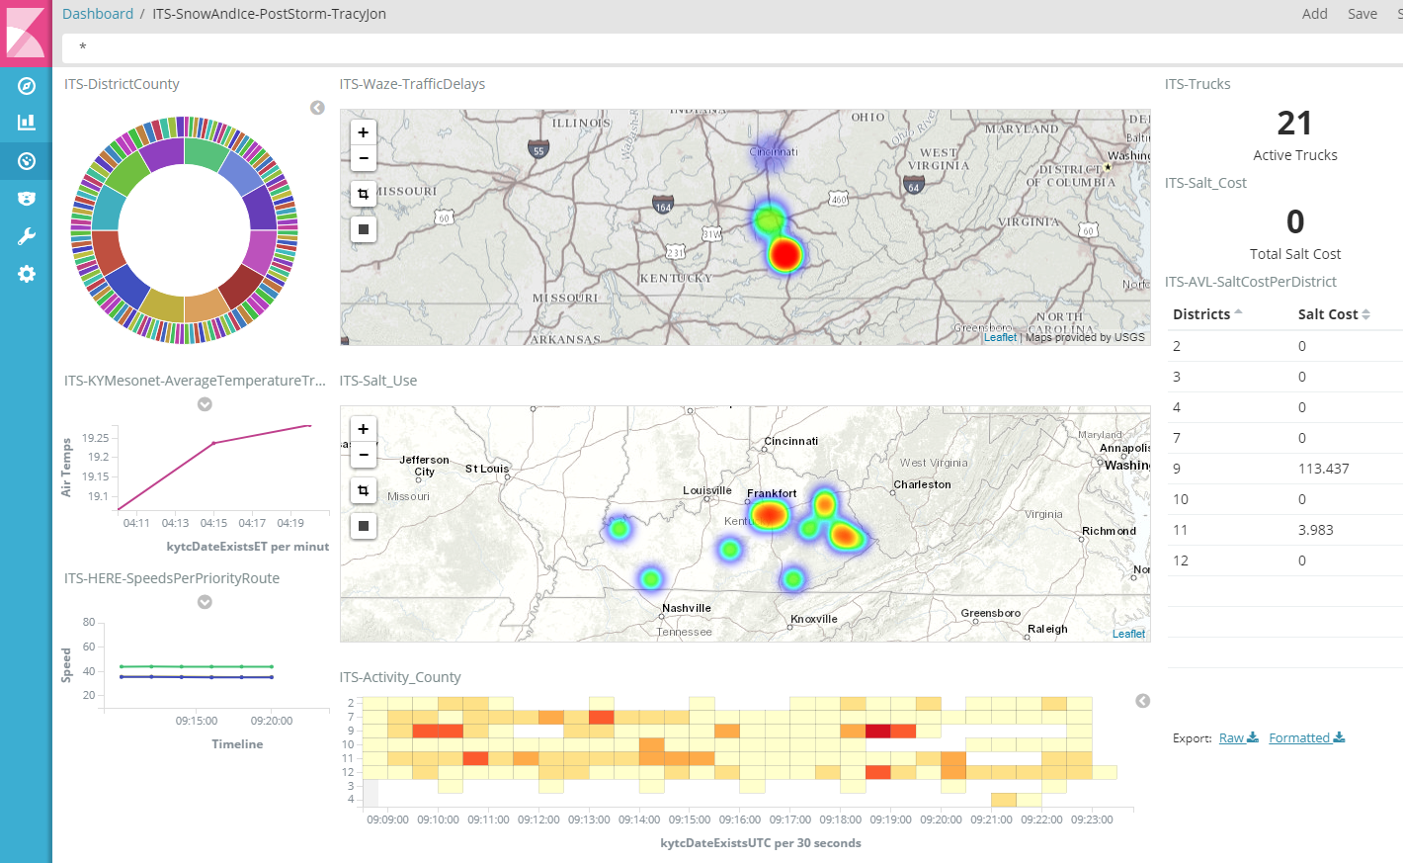
Snow and Ice: Dashboards
Snapshot of Available Data Feeds
Highly Customizable
Real-Time or Historic
Statewide/District/County
Notes:
Chris Lambert will have a breakout session describing our new dashboards that can be customized to show data from various feeds (Waze, HERE Traffic, AVL, Mesonet weather, etc.) You can show data on a map, table, or graph as appropriate for your needs. This can help during an event to make sure routes are being covered appropriately and to monitor activity in adjacent districts.

Slide 7
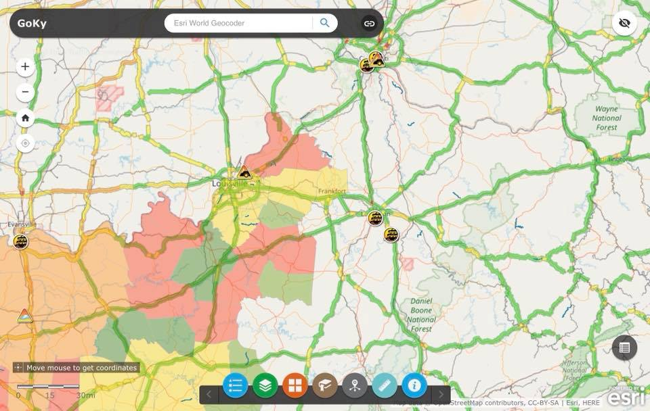
Snow and Ice: Miscellaneous
Report Activity in GoKY
Ask for assistance if needed
Strike Force
Adjacent Districts
Division of Forestry Drivers
Remember policy is not “bare pavement”
Notes:
Please make sure you’re updating the GoKY maps as your activity changes. This is helpful for us in Central Office and for adjacent districts. Also helps public to know where activity is occurring.
Be sure to ask for help if needed. We have the strike force for extreme events, and you can look to your neighbors for help if they are not getting hit also.
Remember that our policy is to “keep traffic moving in a safe manner with an emphasis on maintaining mobility along critical corridors and priority routes”. This does not require that we strive to achieve bare pavement as quickly as possible on all routes. When we focus resources on lower priority routes, we risk not being able to respond on interstates and other high volume roads.

Slide 8
Pavements: Preventive Maintenance
Program increased from $4.4M in 2016 to $18.3M in 2017.
580 lane-miles addressed at cost of $31,500 per mile.
More contractors, including in-state contractors participating.
One in-state contractor awarded multiple micro-surfacing contracts.
Planning for $20M - $25M in 2018.

Slide 9
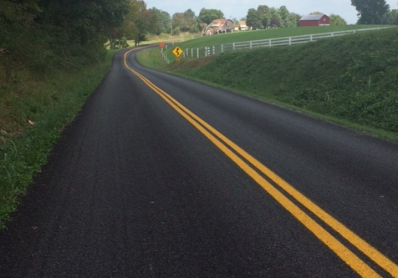
Preventive Maintenance: Focus Areas
Improved Specifications
Communication
Contractor Training
Inspector Training

Slide 10
National Recognition for Program
KYTC to be featured in Pavement Preservation Journal series on World Class Preservation Programs

Slide 11
Pavements: Resurfacing Program
Planning for $105M budget
$5M to be set aside for Low Volume Roads
Approximately 635 miles (20 year cycle)
Reviewing District Funding Allocation Program
Notes:
635 Mile Resurfacing program is 20-year cycle. 12 year cycle would take $175M per year.

Slide 12
Preventive Maintenance: Bridges
Pilot projects in D3 and D9
$5 Million in FE02
Low Cost treatments using state forces
Grease bearings
Re-seal joints
Plan to begin doing concrete coatings using Master Agreements

Slide 13
Recommended Highway Plan
Prioritizes Existing Assets Over Capital Projects
Addressing 400 Bridges by Replacement or Rehabilitation
Approximately 1300 Miles of Pavement for Rehab or Resurfacing

Slide 14
Thank You

